Slide 1
Chapter 18 : Concurrency Control

Slide 2
concurrency control
Applications handle a tremendous amount of requests.
Every request reads or updates the state of the database.
one request at a time (read/write) never be able to serve users.
Concurrency solves this by handling multiple requests at the same time.
Waiting time,response time,resourse utilization,efficiency
Types
Lock-based
Time-stamp
Validation based protocols
Make sure consistency

Slide 3
Lock-Based Protocols
A lock is a mechanism to control concurrent access to a data item
Data items can be locked in two modes :
1. exclusive (X) mode. Data item can be both read as well as
written. X-lock is requested using lock-X instruction.
2. shared (S) mode. Data item can only be read. S-lock is
requested using lock-S instruction.
Lock requests are made to concurrency-control manager. Transaction can proceed only after request is granted.
consistency

Slide 4
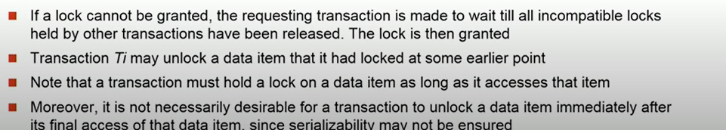
Lock-Based Protocols (Cont.)
Lock-compatibility matrix
A transaction may be granted a lock on an item if the requested lock is compatible with locks already held on the item by other transactions
Any number of transactions can hold shared locks on an item,
But if any transaction holds an exclusive on the item no other transaction may hold any lock on the item.

Slide 5
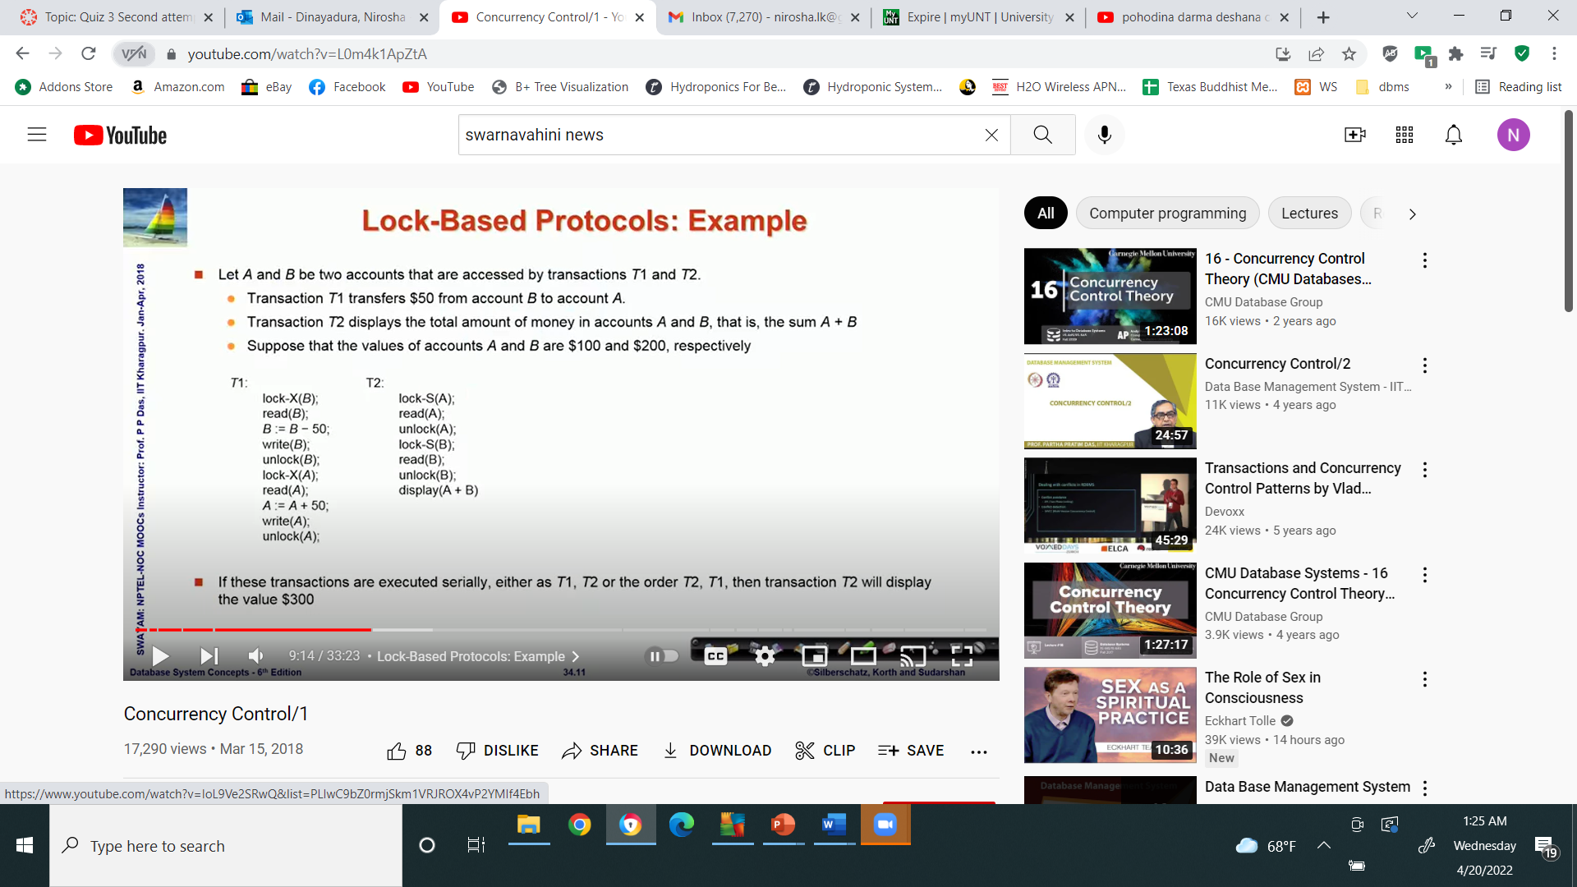
Lock-Based Protocols (Cont.)
Example of a transaction performing locking:
T₂: lock-S(A);
read (A);
unlock(A);
lock-S(B);
read (B);
unlock(B);
display(A+B)
Locking as above is not sufficient to guarantee serializability

Slide 6
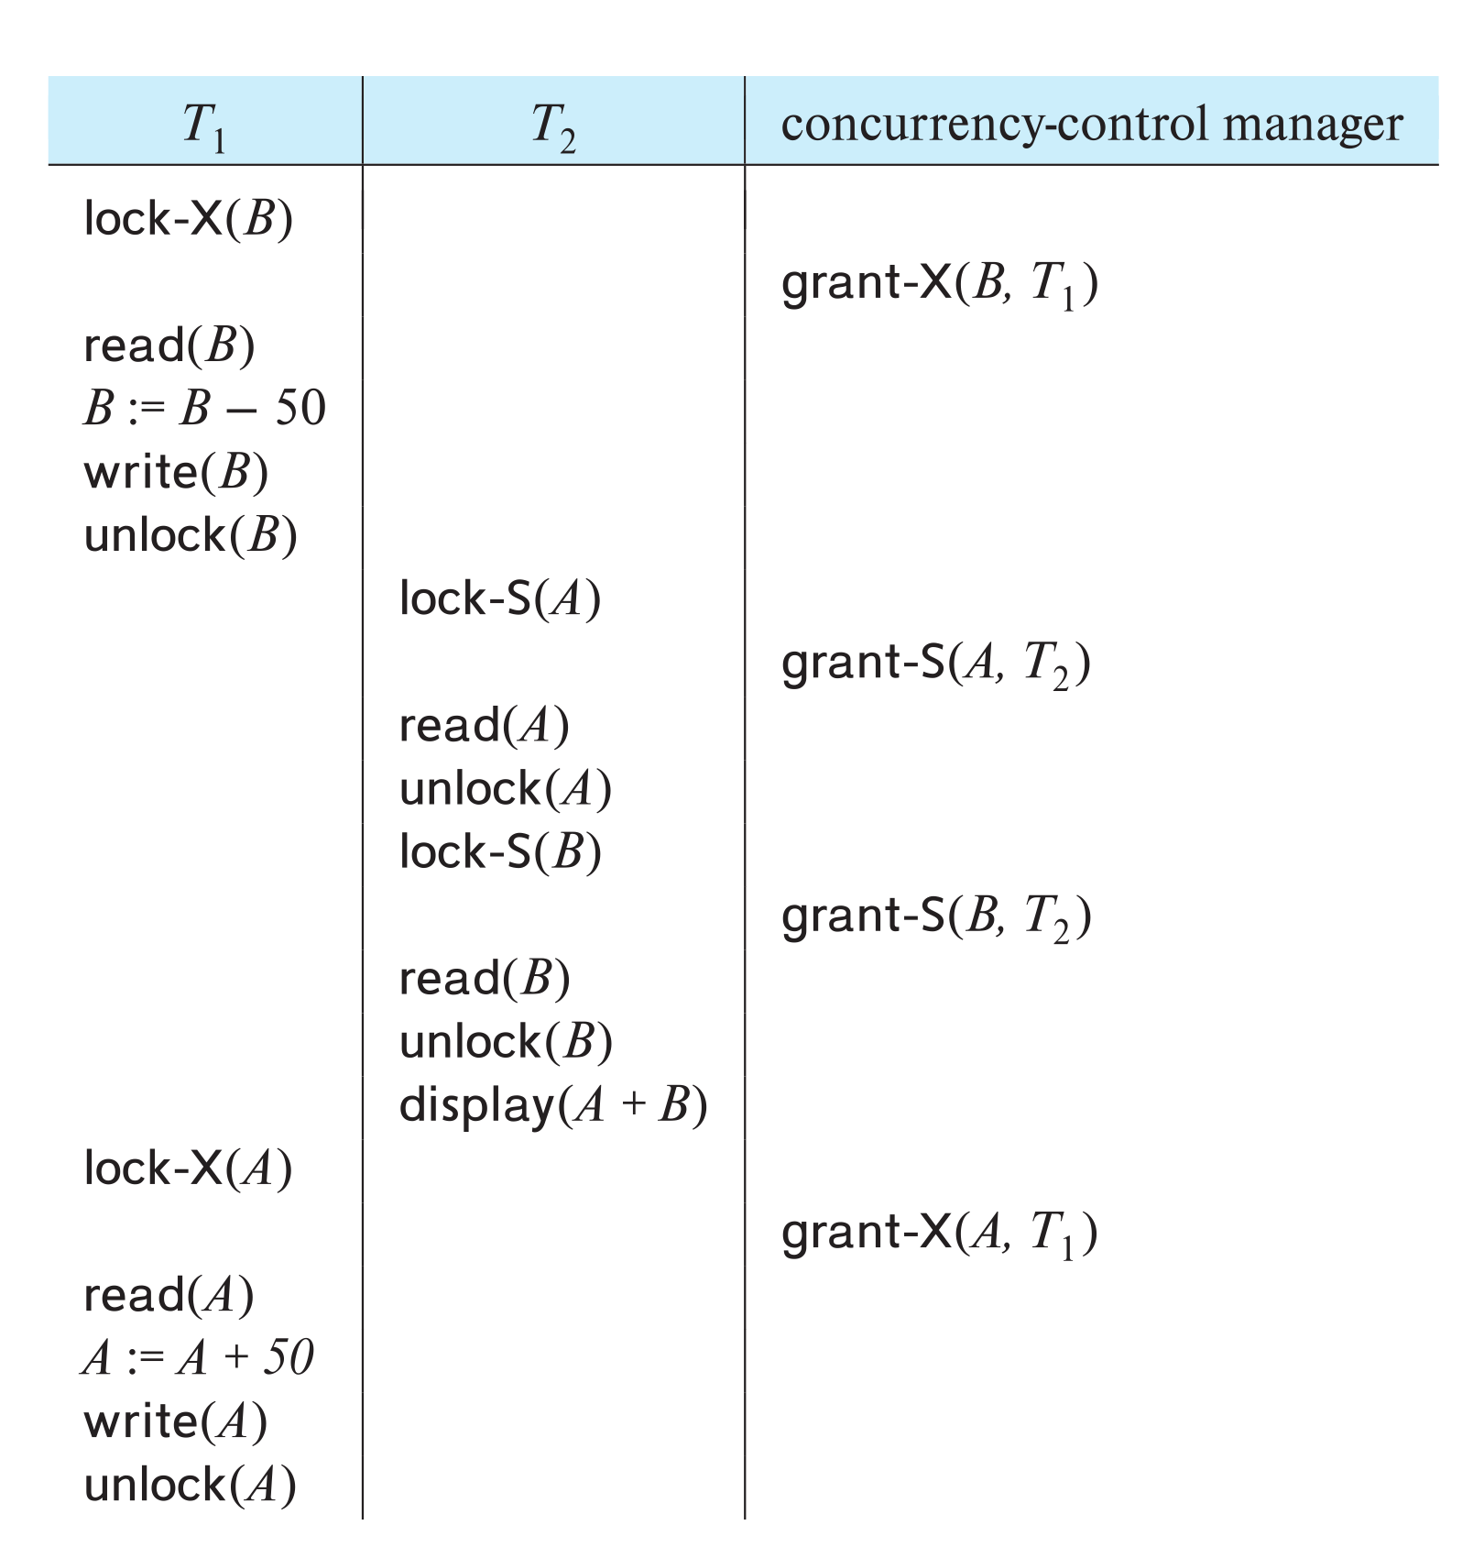
Schedule With Lock Grants
Grants omitted in rest of chapter
Assume grant happens just before the next instruction following lock request
This schedule is not serializable (why?)
A locking protocol is a set of rules followed by all transactions while requesting and releasing locks.
Locking protocols enforce serializability by restricting the set of possible schedules.
T1 unlock data item b too early

Slide 7
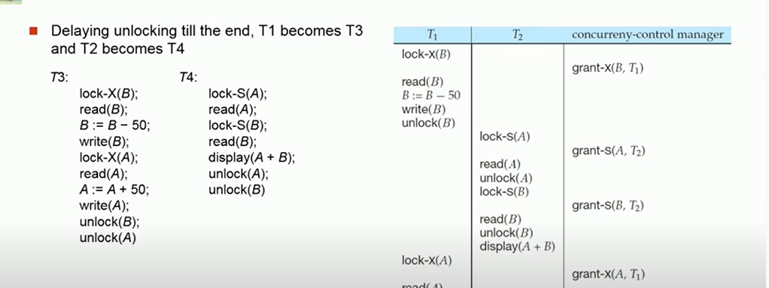
,
.

Slide 8
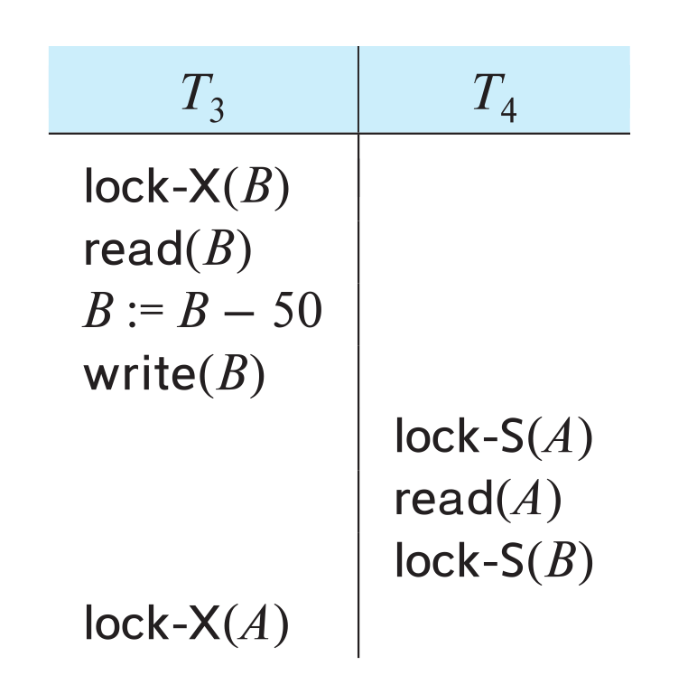
Deadlock
Limitations of lock based protocall
1. Consider the partial schedule
Since T3 is holding an exclusive mode lock on B and T4 is requising a shared-mode lock on B, T4 is waiting for T3 to unlock B
Similarly. Since T4 is holding a shared-mode lock on A and T3 is requisting an exclusive –mode lock on A,T3 is waiting for T4 to unlock A
Neither T₃ nor T₄ can make progress — executing lock-S(B) causes T₄ to wait for T₃ to release its lock on B, while executing lock-X(A) causes T₃ to wait for T₄ to release its lock on A.
Such a situation is called a deadlock.
To handle a deadlock one of T₃ or T₄ must be rolled back and its locks released.

Slide 9
Deadlock (Cont.)
The potential for deadlock exists in most locking protocols. Deadlocks are a necessary evil.
Starvation is also possible if concurrency control manager is badly designed. For example:
A transaction may be waiting for an X-lock on an item, while a sequence of other transactions request and are granted an S-lock on the same item.
The same transaction is repeatedly rolled back due to deadlocks.
Concurrency control manager can be designed to prevent starvation.
(Starvation occurs if a process is indefinitely postponed. This may happen if the process requires a resource for
execution that it is never alloted or
if the process is never provided the
processor for some reason.)
T1 | T2 | T3 | T4
Lock-S(A)
R(A)
 | Lock-X(A)
 | R/W(A)
 |  | Lock-S(A)
 |  | R(A)
 |  |  | Lock-S(A)
 |  |  | R(A)

Slide 10
The Two-Phase Locking Protocol
A protocol which ensures conflict-serializable schedules. –lock and unlock requst
Phase 1: Growing Phase
Transaction may obtain locks
Transaction may not release locks
Phase 2: Shrinking Phase
Transaction may release locks
Transaction may not obtain locks
The protocol assures serializability. It can be proved that the transactions can be serialized in the order of their lock points (i.e., the point where a transaction acquired its final lock).
Locks
Time

Slide 11
The Two-Phase Locking Protocol (Cont.)
Two-phase locking does not ensure freedom from deadlocks
Extensions to basic two-phase locking needed to ensure recoverability of freedom from cascading roll-back
Strict two-phase locking: a transaction must hold all its exclusive locks till it commits/aborts.
Ensures recoverability and avoids cascading roll-backs
Rigorous two-phase locking: a transaction must hold all locks till commit/abort.
Transactions can be serialized in the order in which they commit.
Most databases implement rigorous two-phase locking, but refer to it as simply two-phase locking
Notes:
842

Slide 12
Two-Phase Locking
T1 | T2
Lock-S(A)
R(A)
Lock-X(B)
R(B)
W(B)
Unlock (A)
Unlock(B)
C | Lock-S(A)
 | R(A)
 | Lock-X(B)
 | R(B)
 | W(B)
 | Unlock (A)
 | Unlock(B)
 | C
Strict two-phase locking: a transaction must hold all its exclusive locks till it commits/aborts.
Ensures recoverability and avoids cascading roll-backs
T1 | T2
Lock-S(A)
R(A)
Lock-X(B)
R(B)
W(B)
Unlock (A)
 | Lock-S(A)
 | R(A)
 | Unlock(A)
)
Unlock(B)
C
 | C
Rigorous two-phase locking: a transaction must hold all locks till commit/abort.
Transactions can be serialized in the
order in which they commit.
Strict
Rigorous
Notes:
Rigorous

Slide 13
Locking Protocols
Given a locking protocol (such as 2PL)
A schedule S is legal under a locking protocol if it can be generated by a set of transactions that follow the protocol
A protocol ensures serializability if all legal schedules under that protocol are serializable

Slide 14
Lock Conversions
Two-phase locking protocol with lock conversions:
– Growing Phase:
can acquire a lock-S on item
can acquire a lock-X on item
can convert a lock-S to a lock-X (upgrade)
– Shrinking Phase:
can release a lock-S
can release a lock-X
can convert a lock-X to a lock-S (downgrade)
This protocol ensures serializability
upgrade
downgrade
Notes:
downgrade

Slide 15
Automatic Acquisition of Locks
A transaction T_{i} issues the standard read/write instruction, without explicit locking calls.
The operation read(D) is processed as:
if T_{i} has a lock on D
then
read(D)
else begin
if necessary wait until no other
transaction has a lock-X on D
grant T_{i} a lock-S on D;
read(D)
end
A simple scheme automatically generates appropriate lock and unlock instructions for a transaction

Slide 16
Automatic Acquisition of Locks (Cont.)
The operation write(D) is processed as:
if T_{i} has a lock-X on D
then
write(D)
else begin
if necessary wait until no other trans. has any lock on D,
if T_{i} has a lock-S on D
then
upgrade lock on D to lock-X
else
grant T_{i} a lock-X on D
write(D)
end;
All locks are released after commit or abort

Slide 17
Implementation of Locking
A lock manager can be implemented as a separate process
Transactions can send lock and unlock requests as messages
The lock manager replies to a lock request by sending a lock grant messages (or a message asking the transaction to roll back, in case of a deadlock)
The requesting transaction waits until its request is answered
The lock manager maintains an in-memory data-structure called a lock table to record granted locks and pending requests

Slide 18
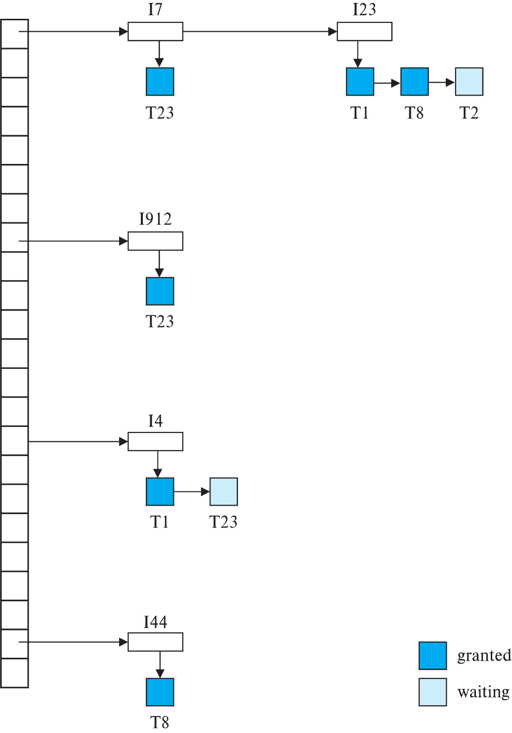




Lock Table
Dark rectangles indicate granted locks, light colored ones indicate waiting requests
Lock table also records the type of lock granted or requested
New request is added to the end of the queue of requests for the data item, and granted if it is compatible with all earlier locks
Unlock requests result in the request being deleted, and later requests are checked to see if they can now be granted
If transaction aborts, all waiting or granted requests of the transaction are deleted
lock manager may keep a list of locks held by each transaction, to implement this efficiently

Slide 19
Graph-Based Protocols
Graph-based protocols are an alternative to two-phase locking
Impose a partial ordering (ordered subset of a graph)→ on the set D = {d₁, d₂ ,..., d_{h}} of all data items.
If d_{i} → d_{j} then any transaction accessing both d_{i} and d_{j} must access d_{i} before accessing d_{j}.
Implies that the set D may now be viewed as a directed acyclic graph, called a database graph.
The tree-protocol is a simple kind of graph protocol.

Slide 20

Tree Protocol
Only exclusive locks are allowed.
The first lock by T_{i} may be on any data item. Subsequently, a data Q can be locked by T_{i} only if the parent of Q is currently locked by T_{i}.
Data items may be unlocked at any time.
A data item that has been locked and unlocked by T_{i} cannot subsequently be relocked by T_{i}
T10 : l(B);l(E);l(D);u(B);u(E);l(G);U(D);u(G)
T11:l(D);l(H);u(D);u(H)
T12:l(B);l(E);u(E);u(B)
T13:l(D);l(H);u(D);u(H)

Slide 21
Tree Protocol
 | T10 | T11 | T12 | T13
 | L (B)
 |  | L(D)
 |  | L(H)
 |  | U(D)
 | L(E)
 | L(D )
 | U(B)
 | U(E)
 |  |  | L(B )
 |  |  | L( E)
 |  | U(H)
 | L( G)
 | U( D)
 |  |  |  | L(D )
 |  |  |  | L(H )
 |  |  |  | U(D)
 |  |  |  | U(H)
 |  |  | U(E)
 |  |  | U(B)
 | U(G)
T10 : l(B);l(E);l(D);u(B);u(E);l(G);U(D);u(G)
T11:l(D);l(H);u(D);u(H)
T12:l(B);l(E);u(E);u(B)
T13:l(D);l(H);u(D);u(H)

Slide 22
Graph-Based Protocols (Cont.)
The tree protocol ensures conflict serializability as well as freedom from deadlock.
Unlocking may occur earlier in the tree-locking protocol than in the two-phase locking protocol.
Shorter waiting times, and increase in concurrency
Protocol is deadlock-free, no rollbacks are required
Drawbacks
Protocol does not guarantee recoverability or cascade freedom
Need to introduce commit dependencies to ensure recoverability
Transactions may have to lock data items that they do not access.
increased locking overhead, and additional waiting time
potential decrease in concurrency
Schedules not possible under two-phase locking are possible under the tree protocol, and vice versa.

Slide 23
Deadlock Handling
System is deadlocked if there is a set of transactions such that every transaction in the set is waiting for another transaction in the set.

Slide 24
Deadlock Handling
Deadlock prevention protocols ensure that the system will never enter into a deadlock state. Some prevention strategies:
Require that each transaction locks all its data items before it begins execution (pre-declaration).
Impose partial ordering of all data items and require that a transaction can lock data items only in the order specified by the partial order (graph-based protocol).

Slide 25
.
.
 | a. Prevention | a. No cycle wait | 1.Conservative two phase locking
 |  |  | b. Ordering based protocol ex:tree protocol
 |  | b. Roll back | 1.wait die
Deadlock |  |  | 2. wound wait
 |  | c.timeout based Schema
 | b.detection recovery | a.wait for graph
 |  | b. Rollback | 1. Total rollback
 |  |  | 2.Partial rollback
Conservative two phase locking – lock all the data before execution- all or non
Notes:
Conservative two phase locking – lock all the data before execution- all or non

Slide 26
preemption
T1 | T2
Lock x(A)
Lock x(B)
 | Lock x(A)
 | Lock x(B)
 | oldest | older | younger
wait die | wait | gets the lock | rollback
wound wait | gets the lock | rollback | wait
wait-die
wound-wait scheme — preemptive
9.00 am | 10.00 am | 11.00 am
Ti | Tj | Tk
 | Lock x(A)
 | Lock x(B)
Lock x(A) |  | rollback
Lock x(B)
 |  | Lock x(A)
wait |  | Lock x(B)
older- wait
newer rollback
older gets the lock
9.00 am | 10.00 am | 11.00 am
Ti | Tj | Tk
 | Lock x(A)
 | Lock x(B)
Lock x(A) |  | wait
Lock x(B)
 | rollback | Lock x(A)
lock |  | Lock x(B)
newer wait
older rollback
oldest gets the lock
Notes:
wait-die scheme — non-preemptive
Older transaction may wait for younger one to release data item.
Younger transactions never wait for older ones; they are rolled back instead.
A transaction may die several times before acquiring a lock
oldest older younger wait die wait gets the lock rollback wound wait gets the lock rollback wait
wound-wait scheme — preemptive
Older transaction wounds (forces rollback) of younger transaction instead of waiting for it.
Younger transactions may wait for older ones.
Fewer rollbacks than wait-die scheme

Slide 27
More Deadlock Prevention Strategies
wait-die scheme — non-preemptive
Older transaction may wait for younger one to release data item.
Younger transactions never wait for older ones; they are rolled back instead.
A transaction may die several times before acquiring a lock
wait-die
9.00 am | 10.00 am | 11.00 am
Ti | Tj | Tk
 | Lock x(A)
 | Lock x(B)
Lock x(A) |  | rollback
Lock x(B)
 |  | Lock x(A)
wait |  | Lock x(B)
oldest- wait
newer rollback
older gets the lock
 | oldest | older | younger
wait die | wait | gets the lock | rollback
wound wait | gets the lock | rollback | wait

Slide 28
More Deadlock Prevention Strategies
wound-wait scheme — preemptive
Older transaction wounds (forces rollback) of younger transaction instead of waiting for it.
Younger transactions may wait for older ones.
Fewer rollbacks than wait-die scheme.
In both schemes, a rolled back transactions is restarted with its original timestamp.
Ensures that older transactions have precedence over newer ones, and starvation is thus avoided.
9.00 am | 10.00 am | 11.00 am
Ti | Tj | Tk
 | Lock x(A)
 | Lock x(B)
Lock x(A) |  | wait
Lock x(B)
 | rollback | Lock x(A)
lock |  | Lock x(B)
newer wait
older rollback
oldest gets the lock
 | oldest | older | younger
wait die | wait | gets the lock | rollback
wound wait | gets the lock | rollback | wait

Slide 29
More Deadlock Prevention Strategies
wait-die scheme — non-preemptive
Older transaction may wait for younger one to release data item.
Younger transactions never wait for older ones; they are rolled back instead.
A transaction may die several times before acquiring a lock
wound-wait scheme — preemptive
Older transaction wounds (forces rollback) of younger transaction instead of waiting for it.
Younger transactions may wait for older ones.
Fewer rollbacks than wait-die scheme.
In both schemes, a rolled back transactions is restarted with its original timestamp.
Ensures that older transactions have precedence over newer ones, and starvation is thus avoided.

Slide 30
Deadlock prevention (Cont.)
Timeout-Based Schemes:
A transaction waits for a lock only for a specified amount of time. After that, the wait times out and the transaction is rolled back.
Ensures that deadlocks get resolved by timeout if they occur
Simple to implement
But may roll back transaction unnecessarily in absence of deadlock
Difficult to determine good value of the timeout interval.
Starvation is also possible

Slide 31

Deadlock Detection
Wait-for graph
Vertices: transactions
Edge from T_{i} →T_{j}. : if T_{i} is waiting for a lock held in conflicting mode byT_{j}
The system is in a deadlock state if and only if the wait-for graph has a cycle.
Invoke a deadlock-detection algorithm periodically to look for cycles.
Wait-for graph without a cycle
Wait-for graph with a cycle

Slide 32
Deadlock Recovery
When deadlock is detected :
Some transaction will have to rolled back (made a victim) to break deadlock cycle.
Select that transaction as victim that will incur minimum cost
Rollback -- determine how far to roll back transaction
Total rollback: Abort the transaction and then restart it.
Partial rollback: Roll back victim transaction only as far as necessary to release locks that another transaction in cycle is waiting for
Starvation can happen (why?)
One solution: oldest transaction in the deadlock
set is never chosen as victim
T1 | T2
Lock-X(A)
R(A)
 | Lock X(B)
 | R(A)
 | W(B)
 | Lock-X(C )
 | R(C )
 | W(C )
 | Lock-X(A)
Lock-X(C)
Notes:
Partial rallback

Slide 33
Multiple Granularity
Allow data items to be of various sizes and define a hierarchy of data granularities, where the small granularities are nested within larger ones
Can be represented graphically as a tree (but don't confuse with tree-locking protocol)
When a transaction locks a node in the tree explicitly, it implicitly locks all the node's descendants in the same mode.
Granularity of locking (level in tree where locking is done):
Fine granularity (lower in tree): high concurrency, high locking overhead It locks the records and fields
Coarse granularity (higher in tree): low locking overhead, low concurrency It is used to lock tables, files, databases, and records.

Slide 34
Example of Granularity Hierarchy
The levels, starting from the coarsest (top) level are
database
area
file
record
The corresponding tree

